Slide 1
ECOSYSTEM Structure and function By Dr. A. S. Shinde SCS College, Omerga

Slide 10
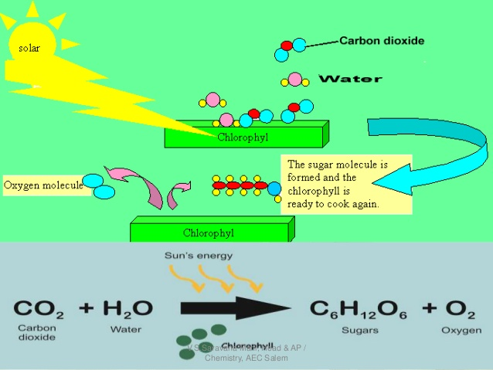

Slide 19
Thank You

